Slide 1

Test assignment for Groupe SEB
Ivan Borzykh

Slide 2
10 reasons why Google Analytics and CRM transactions data may vary
Task 1.1
Customer used AdBlock or similar software, that blocks tracking services
Customer’s browser blocks Google Analytics tracking (declined cookies or used blocking browser)
Issues regarding Google Analytics servers (crashed or down for maintenance)
Google Analytics tracking code inserted incorrectly
Customer disabled JavaScript in his browser
Products amount reached the limit. Amount of information in a single hit is surpasses 8kb
Customer closed his browser before the script loaded
Transaction data is delayed
Transactions are coming through other sources (mobile app, sales manager etc.)
Customer reached 500 hits session limitation.

Slide 3
Reasons why Google Analytics session and user amounts may be different
Task 1.1
Customer has entered the website several times, therefore created several sessions
Customer spent more than 30 minutes on the website.

Slide 4
In which cases Google Analytics and Yandex.Metrika sessions data may be different?
Task 1.1
Both metrics services have different data collection algorithms (different session ending conditions)
One of the services may have servers issues
Customer may set restrictions for either of services
Difference in time zones
4

Slide 5
In which cases Google Analytics and Yandex.Metrika transactions data may be different?
Task 1.1
One of the services may have servers issues
Customer may set restrictions for either of services
Difference in time zones
Google Analytics script Is situated at the bottom of the html page code, unlike Yandex.Metrika script. User may leave before Google Analytics script loads.
5

Slide 6
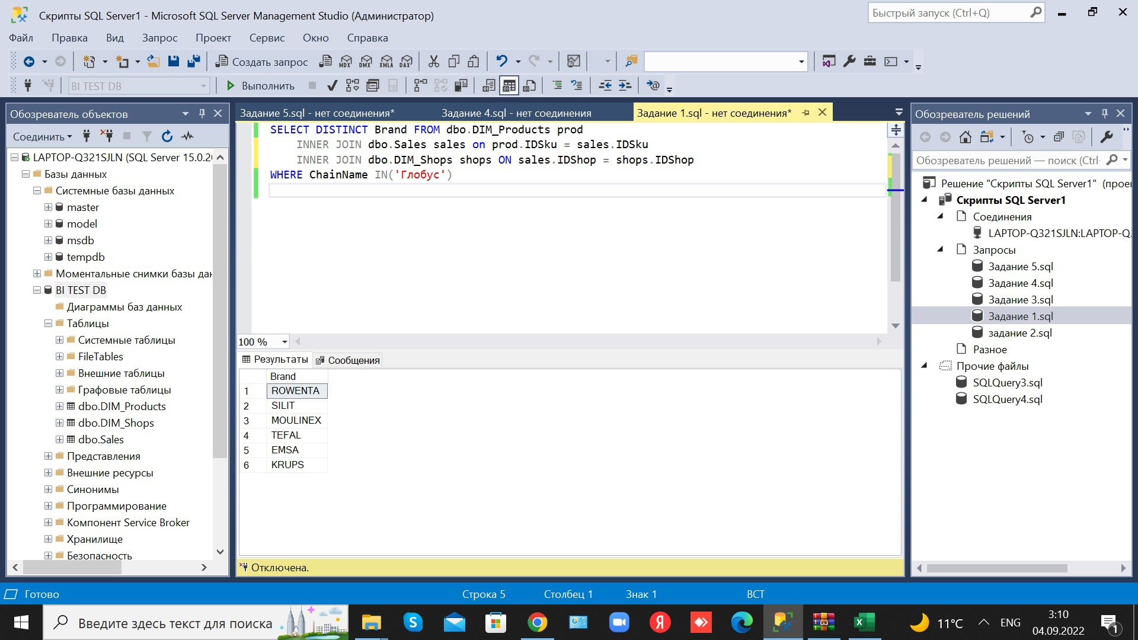
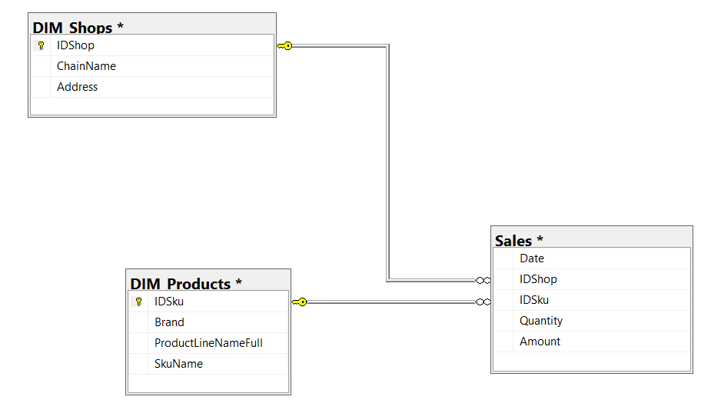
1. Find names of brands that are sold at “Globus” stores
Task 3.1
Query #1 code
Database structure
Query #1 output
6

Slide 7
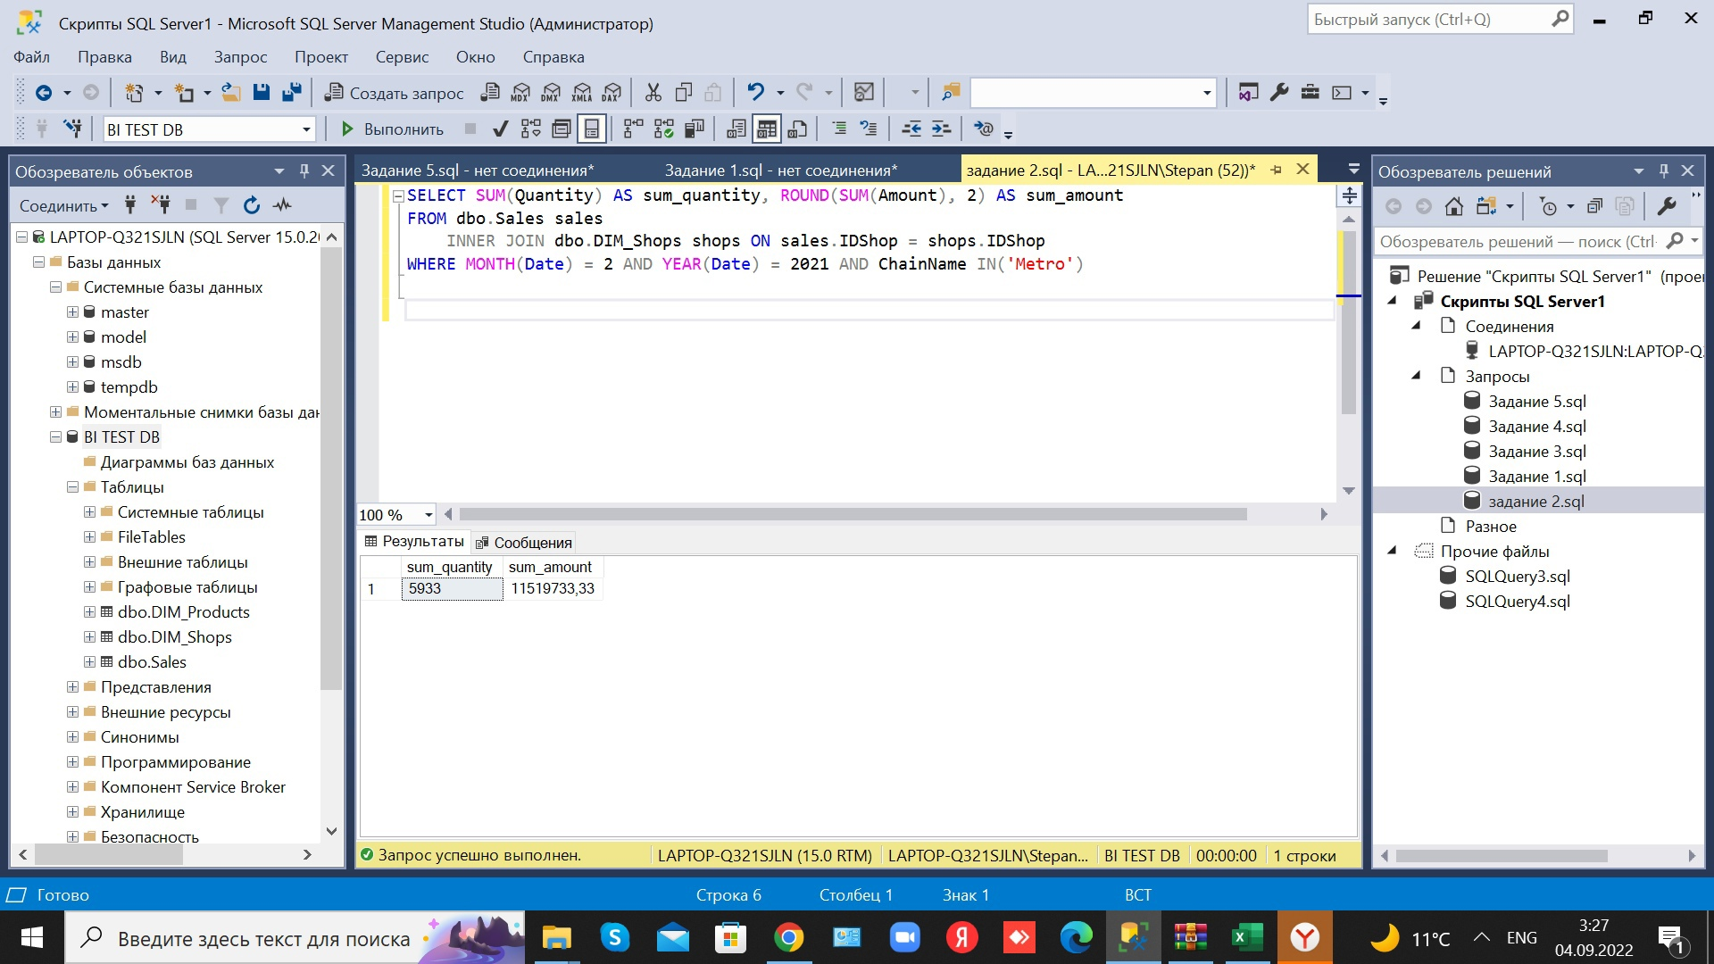
2. Find total sales made in “Metro” stores in February 2021
Task 3.1
Query #2 code
Query #2 output
Database structure
7

Slide 8
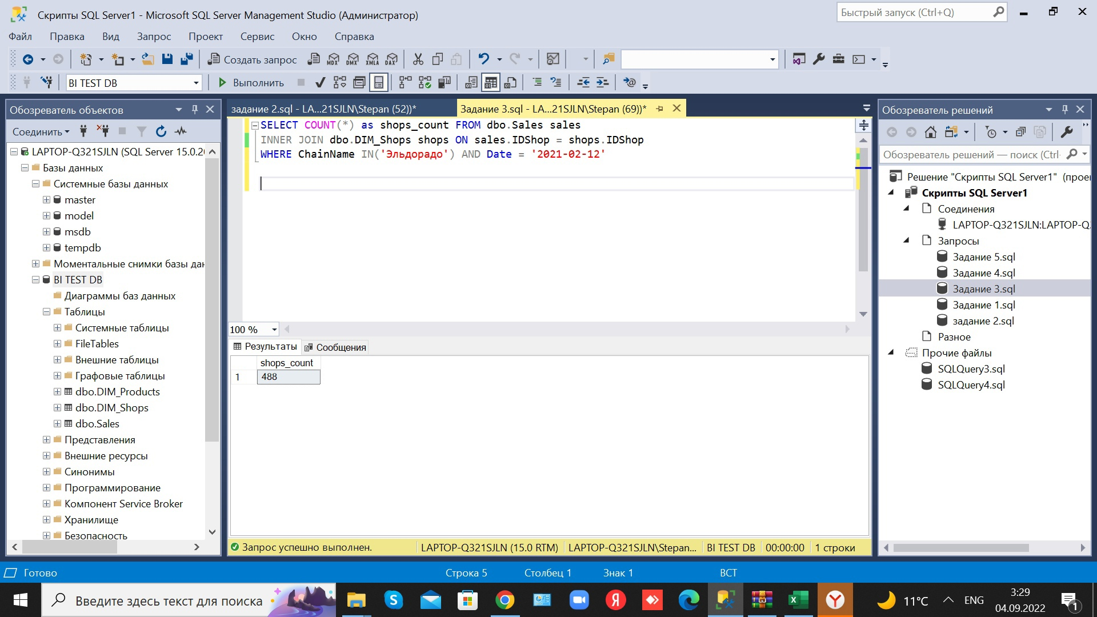
3. Count “Eldorado” stores, that sold products on 21/02/2021
Task 3.1
Query #3 code
Query #3 output
Database structure
8

Slide 9
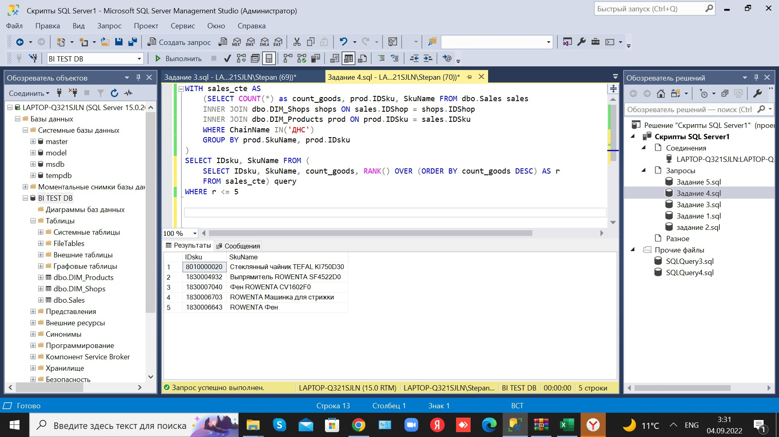
4. Find 5 top-selling products sold at “DNS”
Task 3.1
Query #4 code
Query #4 output
Database structure
9

Slide 10
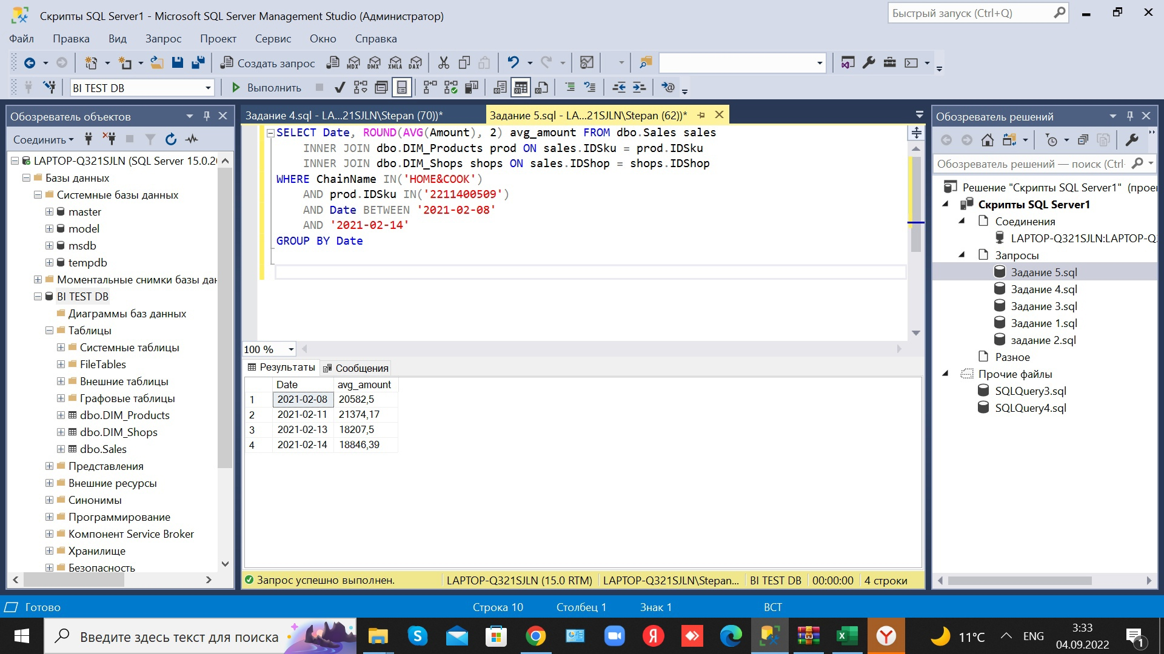
5. Find average daily sales amount of TEFAL VP8561RH at “HOME&COOK” from 08.02.2021 to 14.02.2021
Task 3.1
Query #5 code
Query #5 output
Database structure
10

